Slide 1
WSC Quant
Portfolio Allocation Strategy- Graph theory

Slide 2



Quantitative Finance a brief introduction
Quantitative finance merges finance, math, stats, and tech to enhance financial decision-making using data.
It is a combination of Computer Science,Finance and Mathematics (a lot of mathematics)
Quantitative Researchers are some of the highest paid professionals in the finance world.

Slide 3

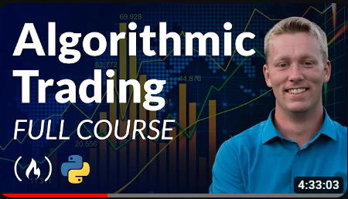
Some Good Resources for beginners.
Learn python : https://youtu.be/rfscVS0vtbw?si=3xg3xbji6ENCTuWt
Build basic Algorithmic trading projects: https://youtu.be/xfzGZB4HhEE?si=7sKTOR5ud_bpvuov

Slide 4
Let’s Get Started!

Slide 5
What is graph theory?
Graph theory is a mathematical field focused on studying graphs—structures comprising vertices connected by edges—to model relationships between entities.
Graphs consist of vertices (points) and edges (lines) that can be directed or undirected, forming a visual representation of connections.
This branch of math finds applications in various disciplines, providing tools to analyze networks, paths, and connectivity among diverse elements.

Slide 6
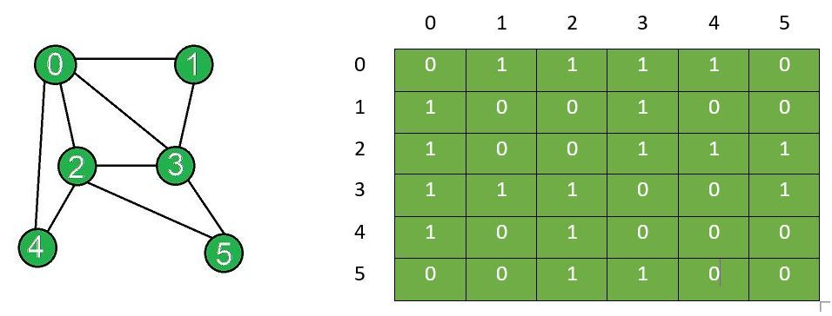
Adjacency matrix to graph conversion:

Slide 7
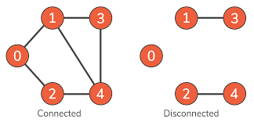
An interesting use case:
Consider all the Starbucks in an area to be nodes.
If the edge represents the distance between the two starbucks locations then you can form clusters and can use that data to better spread out the stores.

Slide 8
The Hypothesis of the strategy.
De- correlated portfolios do better than correlated portfolios.
What is correlation?
Assets that are positively correlated move together and vice versa. This is the fundamental principle over which this strategy operates.
Correlation varies from -1 to 1.

Slide 9
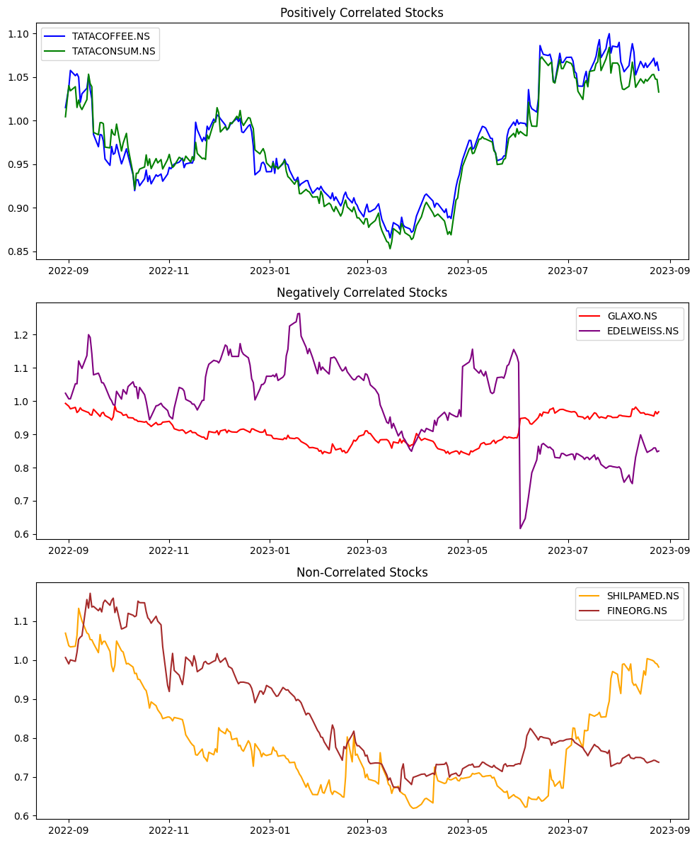

Slide 10
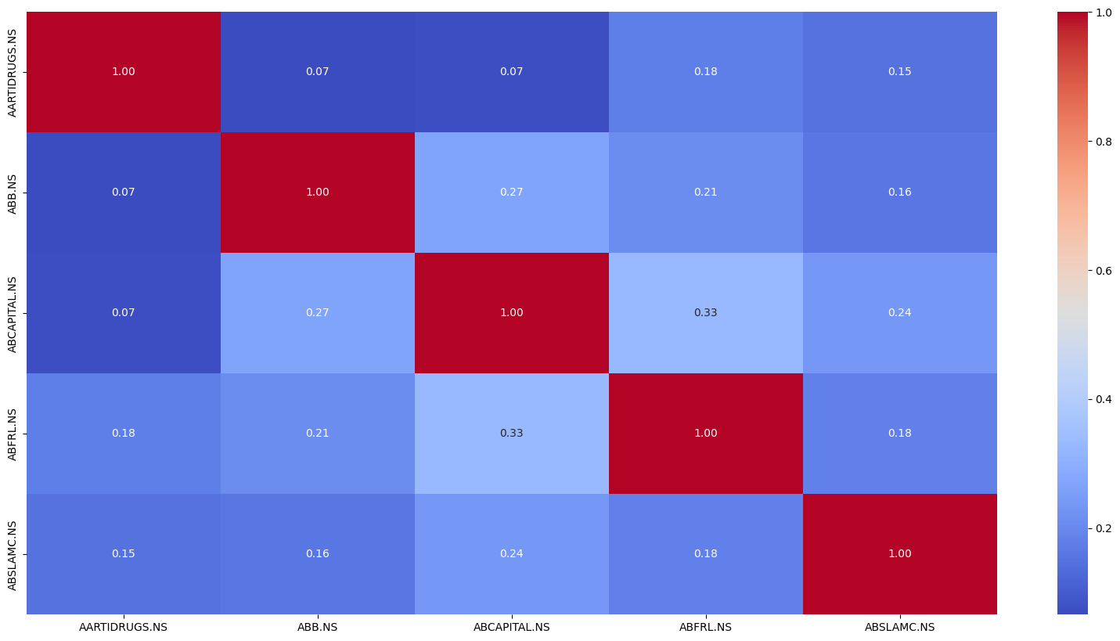
Understanding the correlation matrix
Now we plot the correlation between all stocks with each other.
So 5 stocks will lead to the formation of a matrix of 5x5.

Slide 11
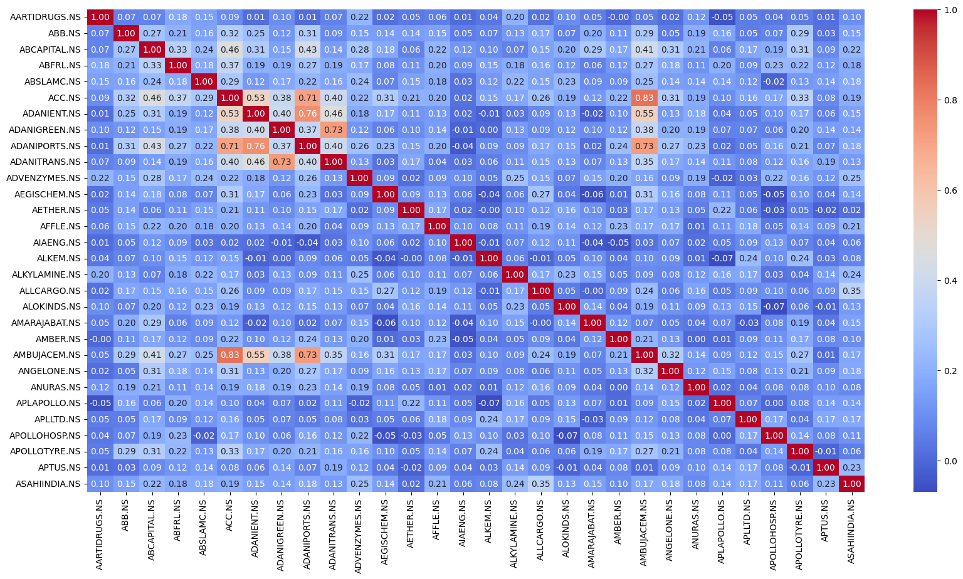
This matrix but bigger!!

Slide 12
Coming to the graph.
Now we will build a graph with the following single rule.
*For our use case the stocks are nodes and their correlations are edges.
If the correlation between two nodes is less than a set threshold value those nodes are connected.
So..

Slide 13
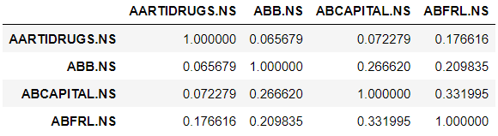
So for a 4x4 matrix of threshold value <=0.33 you get:
ABCAP
AARTI
ABB
ABFRL

Slide 14
The same logic applied to the entire portfolio yields quite a messy graph…

Slide 15
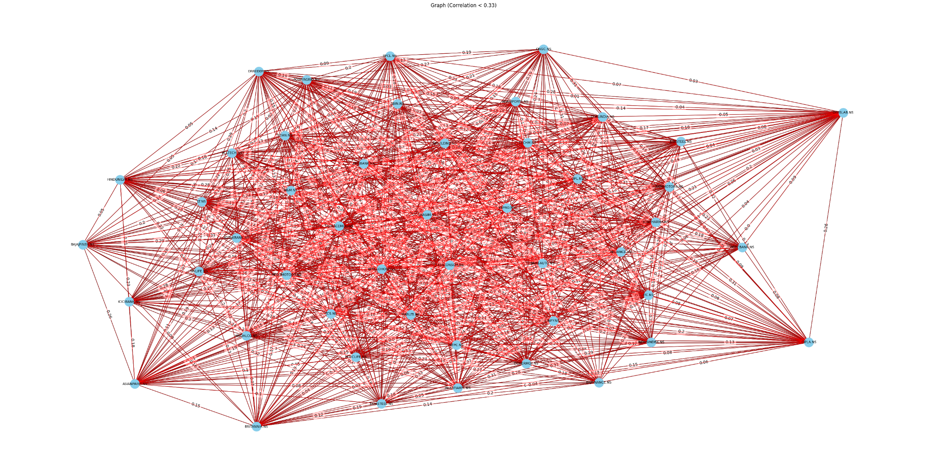

Slide 16
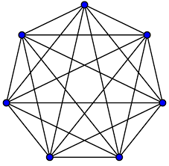
So what is the portfolio we are looking for?
Well the largest complete subgraph.
What is a complete subgraph?
No. of edges emerging from each node is =(total nodes-1)

Slide 17
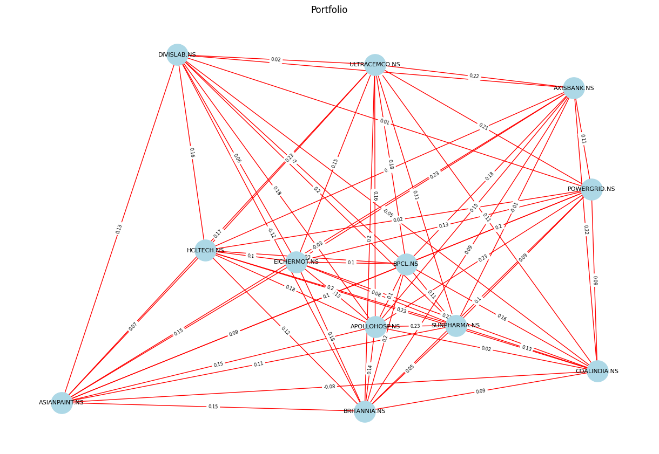

Slide 18
Why Largest Subgraph?
Well think of it intuitively.
The largest subgraph will have the best allocation not only in terms of the number of stocks but also these stocks will for sure be less than 30% correlated to any other stock in the portfolio.

Slide 19
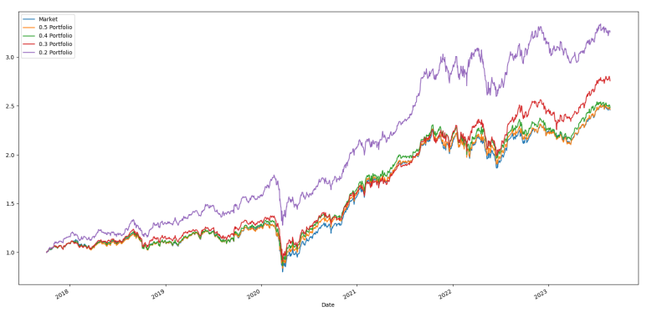
Let's look at some numbers

Slide 20
Got any doubts/ideas get in touch!
f20202184@hyderabad.bits-pilani.ac.in
8459413171
Raghunendra Singh 7991156682

